Slide 1

Welcome

Slide 2
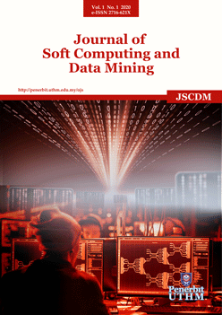
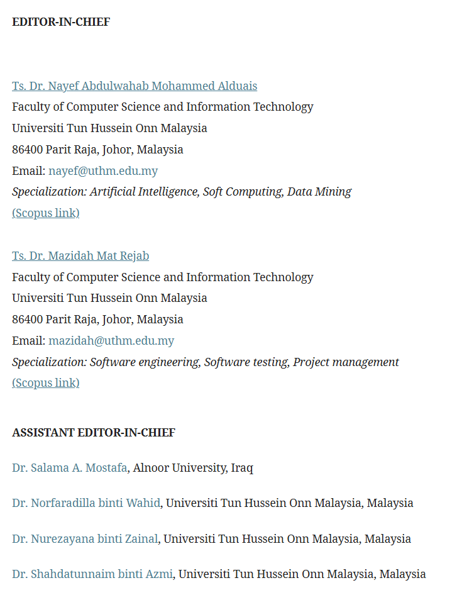

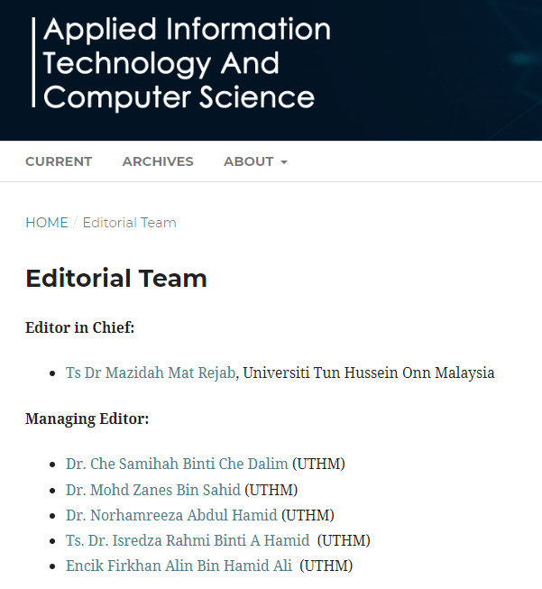
PUBLICATION FSTKM

Slide 3
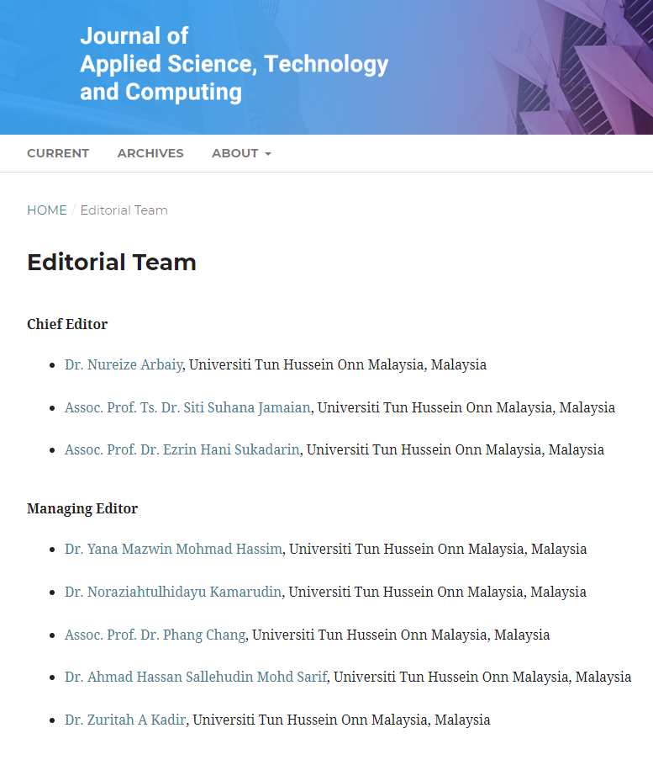
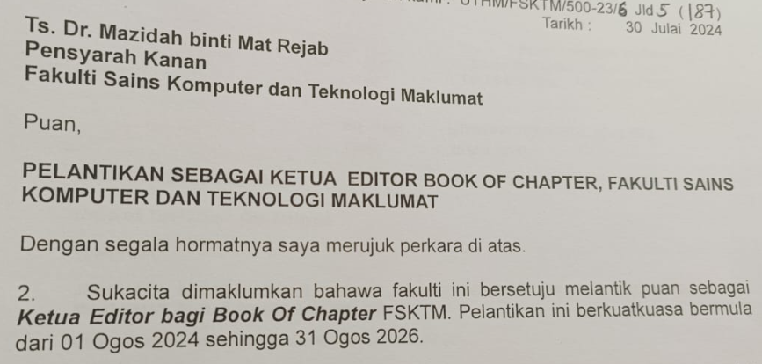
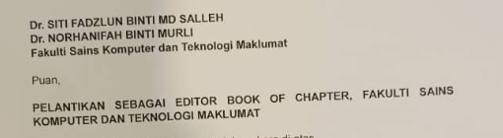
PUBLICATION FSTKM
Book of Chapter

Slide 4
Journal of Soft Computing and Data Mining (JSCDM)
Publisher: Universiti Tun Hussein Onn Malaysia (UTHM)
Platform: Open Journal Systems (OJS)
E-ISSN: 2716-621X
Website: publisher.uthm.edu.my/ojs/index.php/jscdm

Slide 5



INDEX BY

Slide 6
PAPER SUBMISSION SLOT
2026
REGULAR VOLUME
RM 500
2025 | PAPER
REGULAR VOLUME | 50
SPECIAL ISSUES | 17
2026 | PAPER
REGULAR VOLUME MAY | 30
SPECIAL ISSUES | 20-45
REGULAR VOLUME NOV | 30
SPECIAL ISSUE
RM 1500
SLOT WILL INCREASE YEAR BY YEAR

Slide 7
Author Distribution (Regular Issues)
The PAPER PUBLISH should have a 70% contribution from international authors and a 30% contribution from Malaysian authors.
Example Author Distribution:
1 Author: From Malaysia
Other Authors: 5 International authors
Another paper could have 2 Malaysian authors and 4 International authors.

Slide 8
Author Distribution (Special Issues)
40% of the papers to include international authors.
For example, out of 10 papers:
  6 papers can be authored solely by Malaysian researchers.
  4 papers must be collaborations between Malaysian and international authors.

Slide 9
DETAIL
📘 Special Issue Details
1. Name of Special Issue
Special Issue Name: [Insert Special Issue Name]
Example Name: "Advanced Techniques in Soft Computing and Data Mining“
2. Number of Papers
Number of Papers: [Insert Number of Papers]
Example: 10-15 Papers, depending on the submission period.

Slide 10
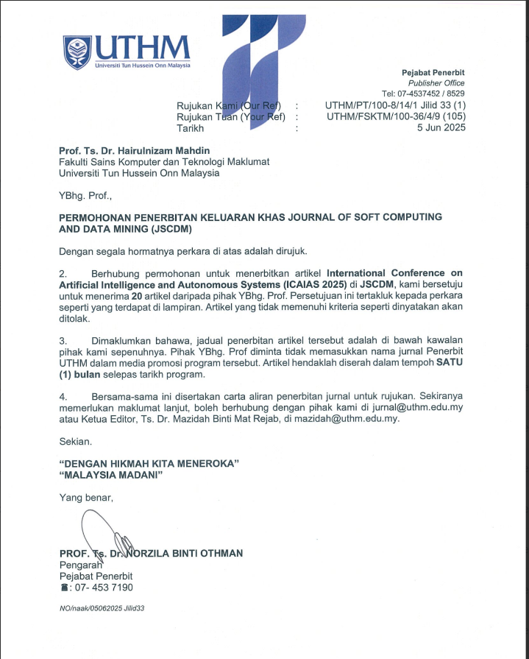
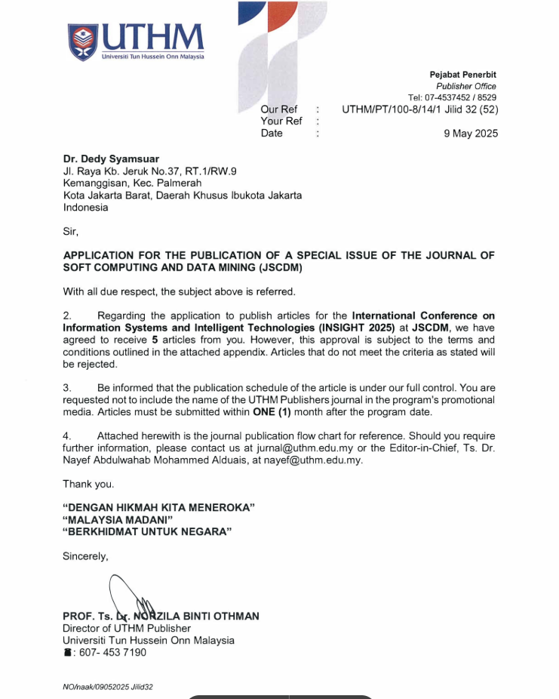
Example Approval Letter

Slide 11
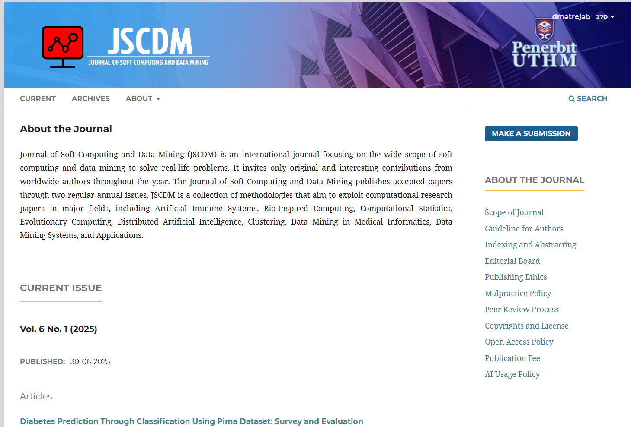

GUIDELINE FOR AUTHOR
https://publisher.uthm.edu.my/ojs/index.php/jscdm/about/submissions

Slide 12
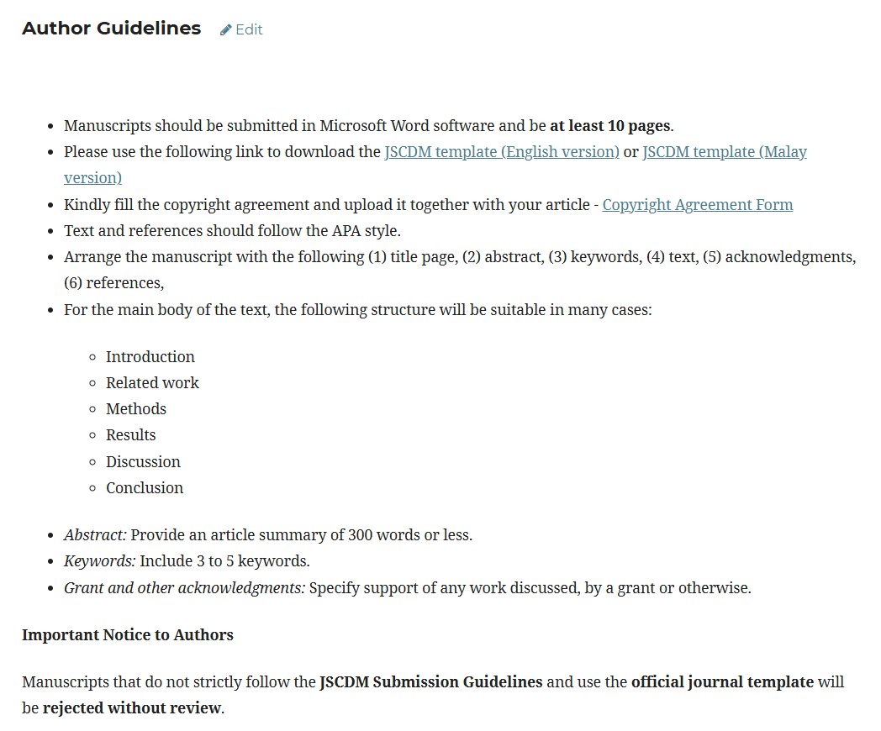

Slide 13
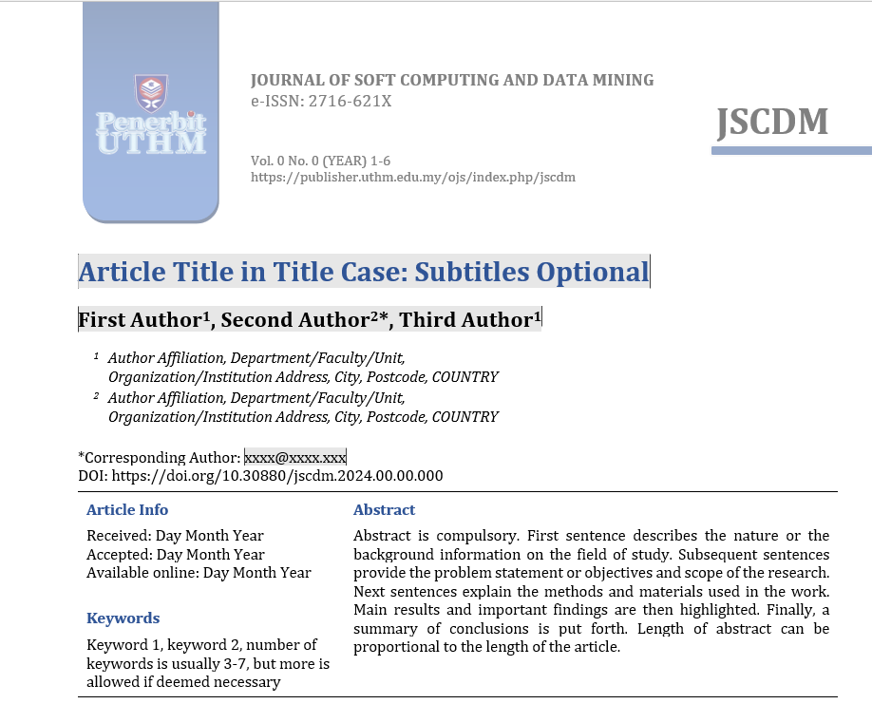
80-150 word only

Slide 14
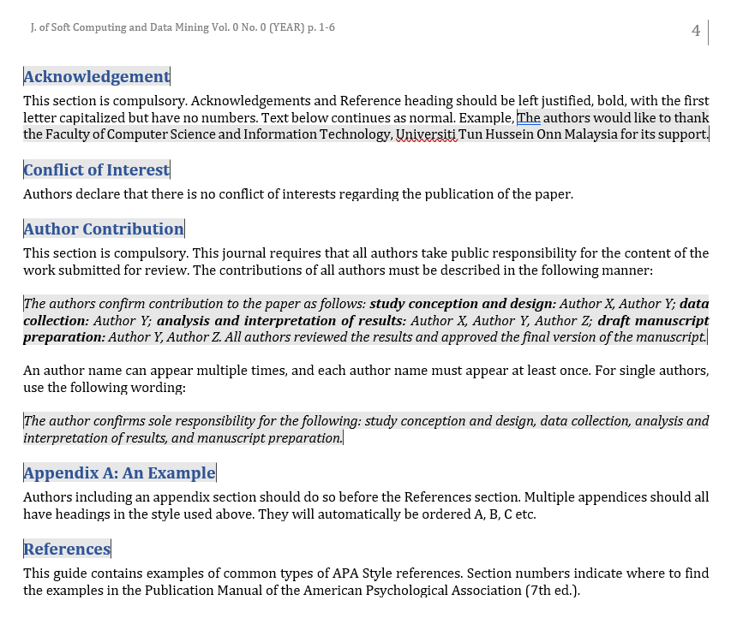
COMPULSARY
TO FILL IN

Slide 15
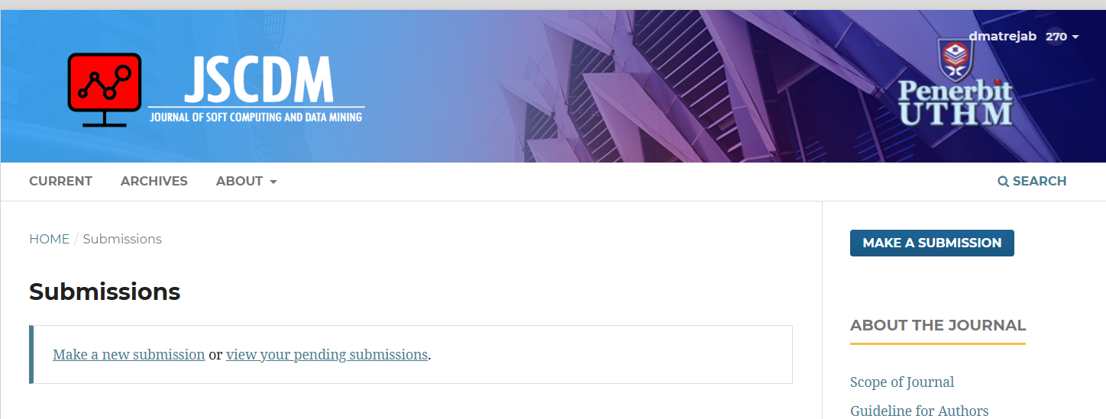
SUBMISSION

Slide 16
EDITORIAL TASK

Slide 17
Editorial Checklist Before Sending
Manuscript for Review and Final Acceptance
✅ Initial Verification
Confirm that the manuscript fits within the scope of the journal.
Ensure the authors’ names in the manuscript exactly match those entered in the submission system.
Check that the copyright form has been completed and properly uploaded.
Perform a similarity check to verify originality and compliance with the journal’s plagiarism policy

Slide 18
Editorial Checklist Before Sending
Manuscript for Review and Final Acceptance
🔍 Before Assigning to Reviewers
Select reviewers who are specialized in the field and subject area of the manuscript.
Ensure reviewers are not affiliated with the authors and are not from the same institution.
Confirm there are no potential conflicts of interest between reviewers and author

Slide 19
Editorial Checklist Before Sending
Manuscript for Review and Final Acceptance
✏️ If Revisions Are Requested
Inform the authors to revise the manuscript according to reviewers’ comments.
Request a point-by-point response to each reviewer comment.
Ask authors to justify why any specific comment has not been addressed, if applicable.---
🏁 Before Final Acceptance
1) Perform a final similarity check to confirm compliance with originality standards.
2) Ensure all requested revisions have been adequately addressed.

Slide 20
DETAIL
📘 Special Issue Details
3. Scope
The special issue invites papers that address the application, theoretical development, and future trends of soft computing and data mining techniques in various domains. Submissions may cover, but are not limited to, the following areas:
4. Head of Special Issue
Head of Special Issue: [Insert Head Name]

Slide 21
Important Information
- Submission Process: Through the online OJS platform.
- Language: Articles are accepted in English.

Slide 22


Terima Kasih
Thank You

Slide 24


Slide 25


Slide 26


